Slide 1

Notes:
Done

Slide 2

Notes:
Done

Slide 3
CIS 700-004: Lecture 4M
Deep vs. shallow learning
02/04/19
Notes:
Done

Slide 4
Course Announcements
Homework has not been released yet. Keep relaxing :)
Notes:
Done

Slide 5
Design in deep learning
Deep learning is not a science yet.
We don’t know what networks will work for what problems.
People in general just tweak what worked best.
We don’t have answers (yet).
Today, we’ll talk about the start of a science for deep learning - intuition and theory.
Notes:
Done

Slide 6
The intuitive benefits of depth
Notes:
Done

Slide 7
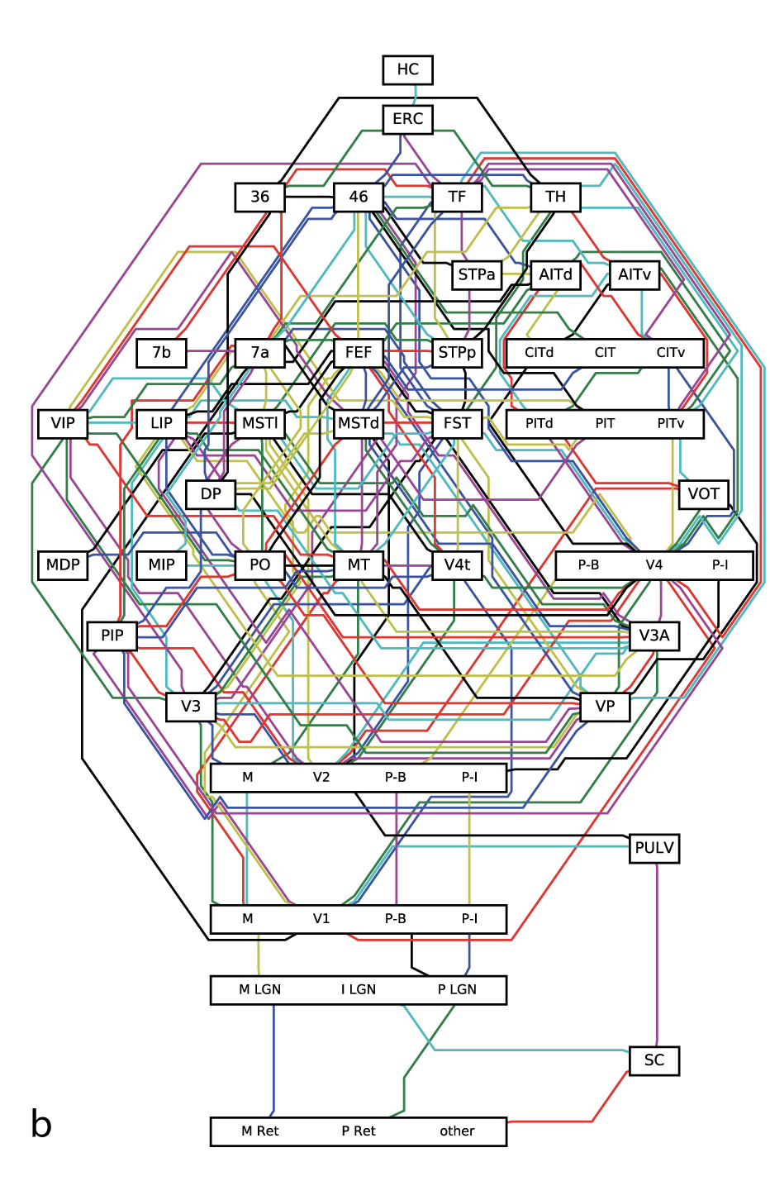
How deep is the brain?
Felleman and vanEssen
Jonas and Kording 2017

Slide 8
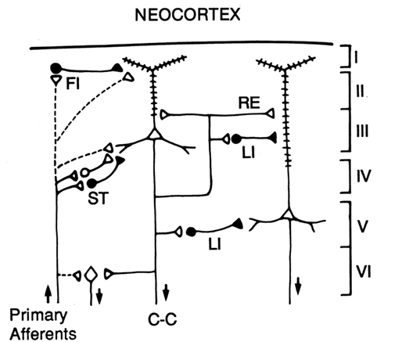
And locally
Shepherd 1994

Slide 9
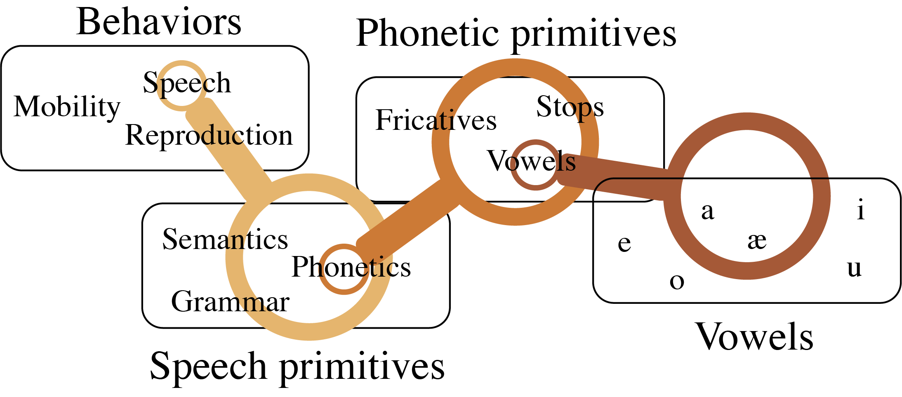
Compositionality in tasks
Notes:
Using a vision example would have been more powerful

Slide 10
End-to-end learning

Slide 11
Expressivity
Notes:
Done

Slide 12
Expressivity
We know even shallow neural nets (=1 hidden layer) are universal approximators under various assumptions.
That could require huge width.
Given a particular architecture, we can looks at its expressivity, or the set of functions it can approximate.
Why do we need to look at approximation here?
Notes:
Done

Slide 13
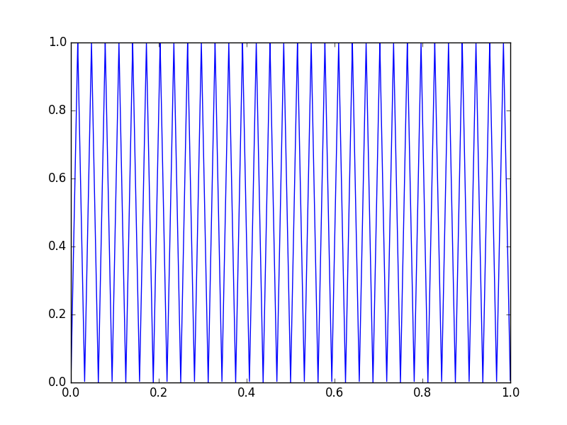
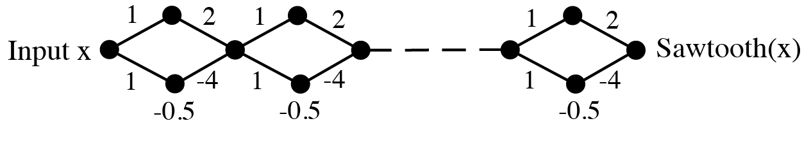
Expressivity gaps: number of linear pieces
Sawtooth function
The sawtooth function with 2^{n} pieces can be expressed succinctly with ~3n neurons (Telgarsky 2015) and depth ~2n.
The naive shallow implementation takes exponentially more neurons.
Notes:
Done

Slide 14
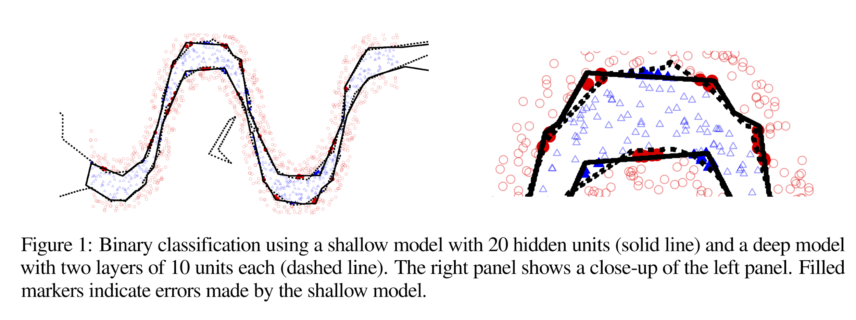
Expressivity gaps: number of linear pieces
Montufar et al. (2014) showed that the number of linear pieces that can be expressed by a deep piecewise linear network is exponential in the depth and polynomial in the number of input dimensions.
Notes:
Done

Slide 15
Expressivity gaps: curvature
Thm: For a bounded activation function, a unit length curve sent through a deep network can grow in length exponentially with the depth. For a shallow network, the length is only linear in the width. (Poole et al. 2016)
Notes:
Done

Slide 16
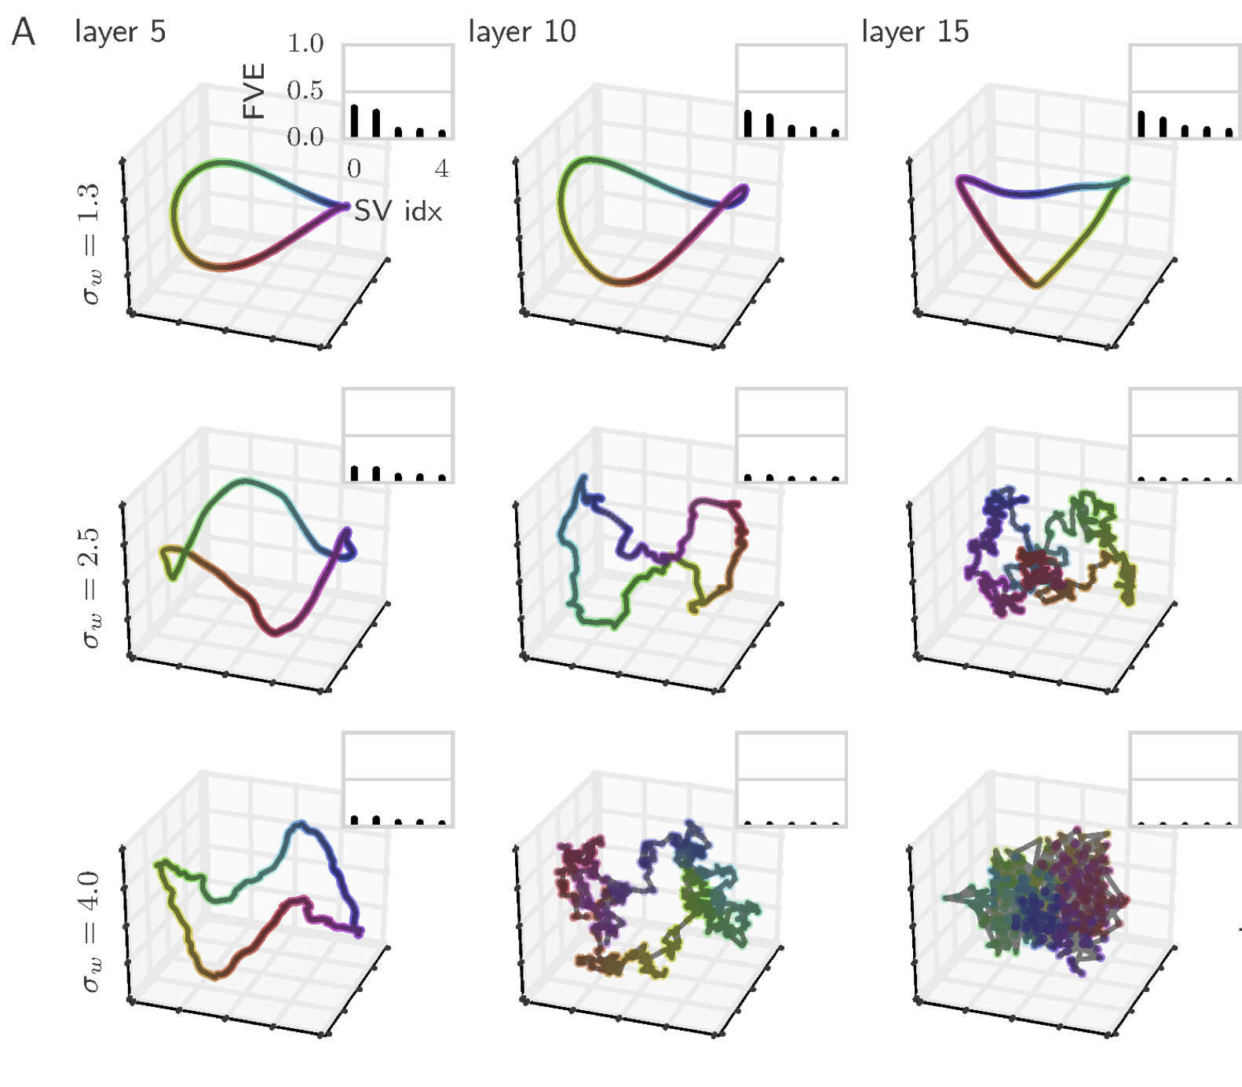
Expressivity gaps: curvature
Thm: For a bounded activation function, a unit length curve sent through a deep network can grow in length exponentially with the depth. For a shallow network, the length is only linear in the width. (Poole et al. 2016)
Empirically, they find that the curvature of the output curve grows exponentially with depth.
They prove this in the infinite-width limit for random networks (i.e., at init).
Infinite-width limit is used in many proofs, though doesn’t capture everything (as we’ll see later).
One example of finite-width effect on variance: if a ReLU layer gets zeroed out.
Notes:
Done

Slide 17
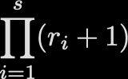
Expressivity gaps: the multiplication problem
Theorem (Lin et al. 2017). For approximating the multiplication of n inputs x₁, x₂, … ,x_{n} to within an arbitrary ε accuracy, a shallow network requires 2^{n} neurons, but a deep net requires only O(n) neurons (linear in n).
Theorem (Rolnick & Tegmark, 2018). More generally, the number of neurons required for a shallow network to approximate the monomial is also exponential in n:
The number of neurons to required to approximate the sum of m monomials is at most 1/m times the number required for each individual monomial. Thus there is also an exponential gap for any (sparse) polynomial.
Notes:
Done

Slide 18
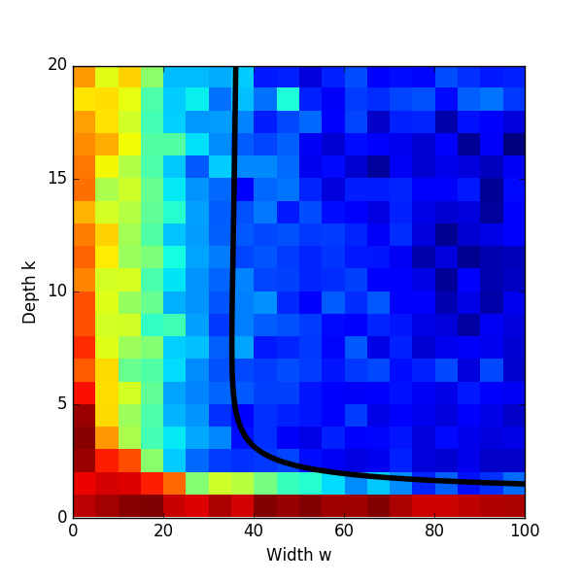

Expressivity gaps: the multiplication problem
Theorem (Rolnick & Tegmark 2018). When using k layers to approximate the product of n inputs, the number of neurons needed is at most:
Conjectured that the bound is tight.
Notes:
Done

Slide 19
Learnability
Notes:
Done

Slide 20
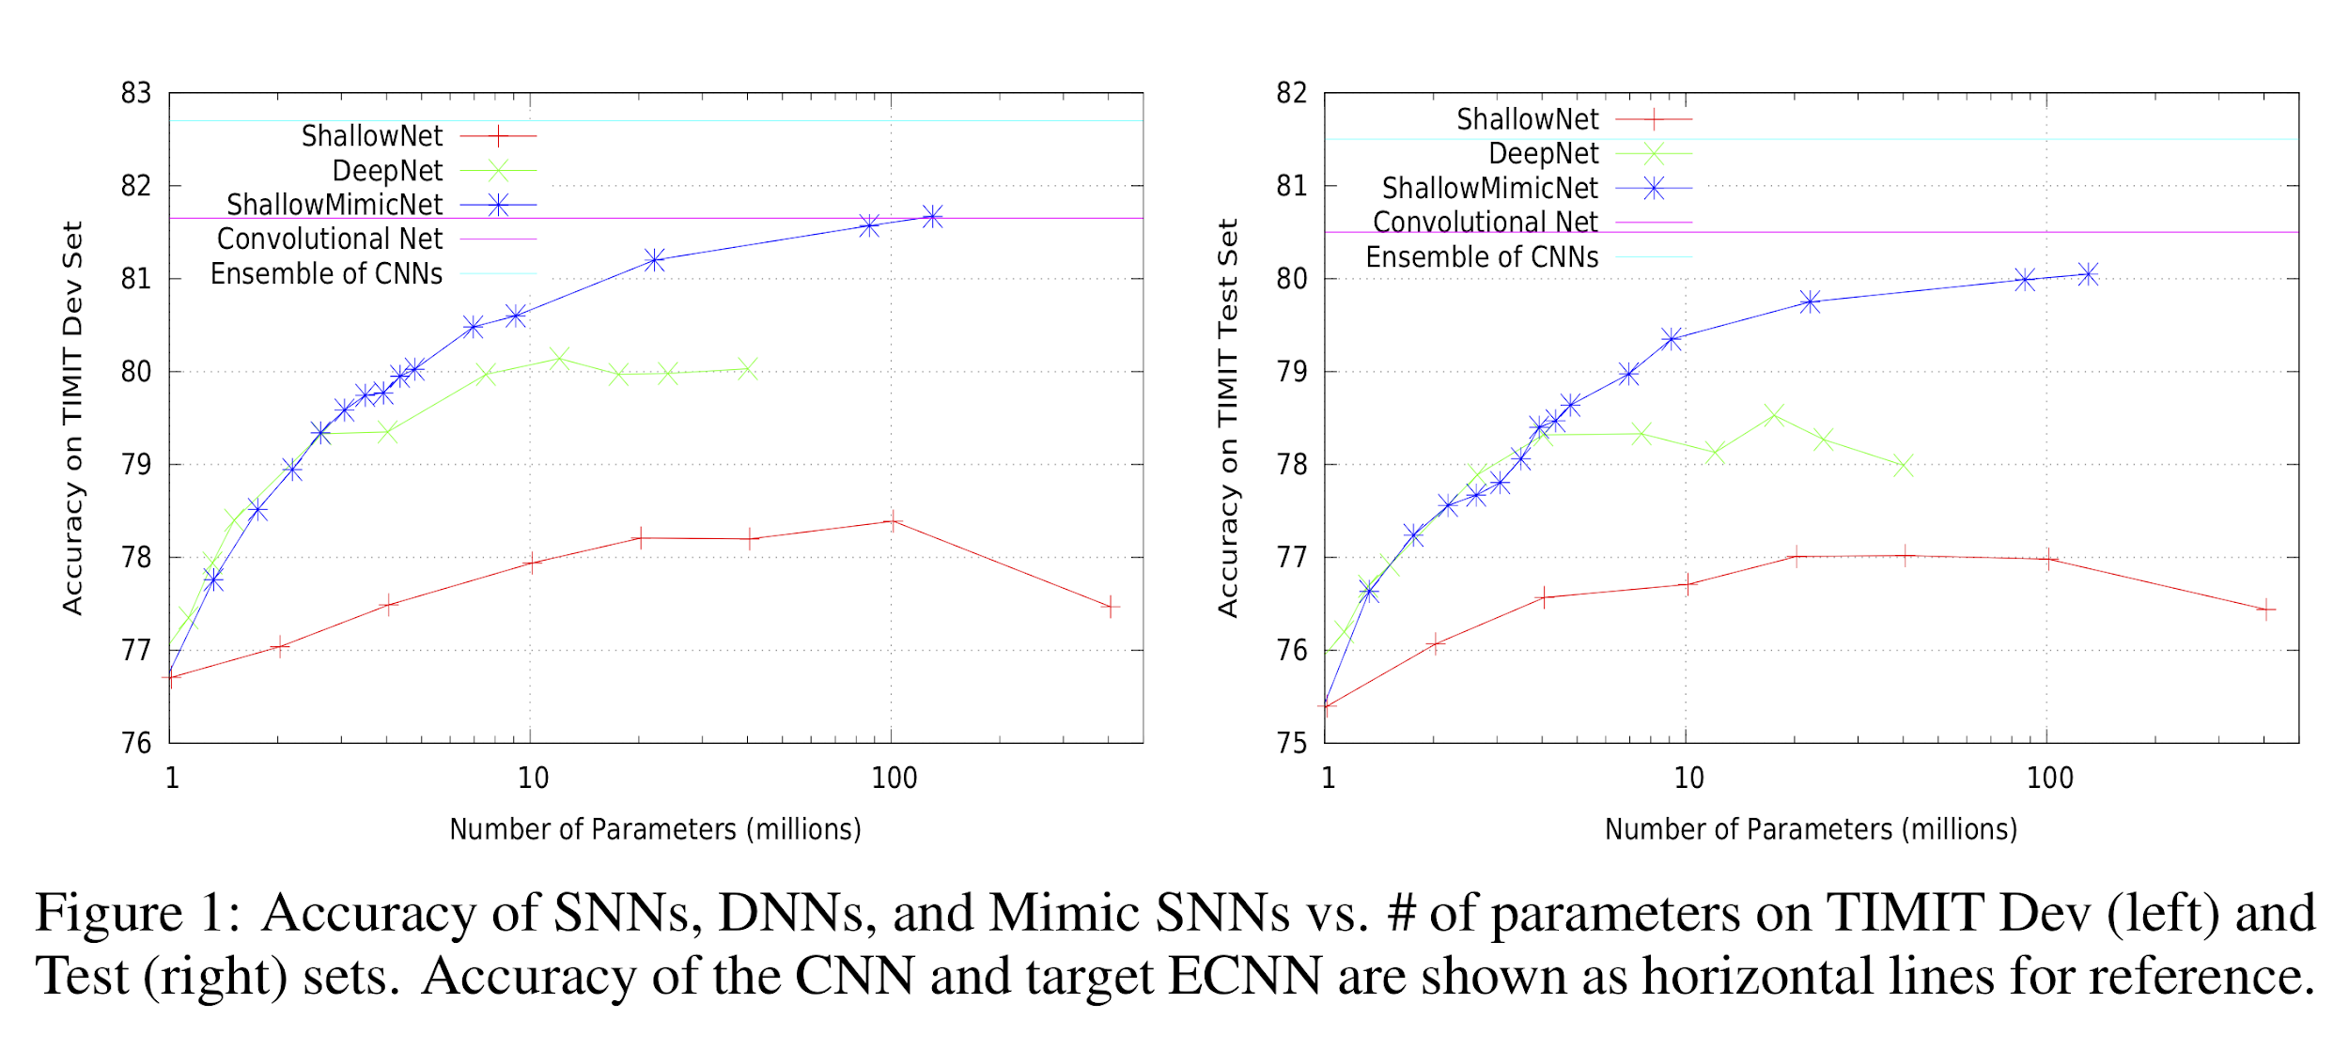
Is expressivity the problem with shallow nets?
Ba & Caruana (2014):
A wide, shallow network can be trained to mimic a deep network, attaining significantly greater accuracy than training the shallow network directly on the data.
Or an ensemble of deep networks.
Notes:
Done

Slide 21
Is expressivity the problem with shallow nets?
Ba & Caruana (2014):
A wide, shallow network can be trained to mimic a deep network, attaining significantly greater accuracy than training the shallow network directly on the data.
Or an ensemble of deep networks.
The mimic networks output the pre-softmax output of the teach networks.
Why is there more information here than simply training on the raw data?
Learnability of deeper networks may be more important than expressivity in practice.
Notes:
Done

Slide 22
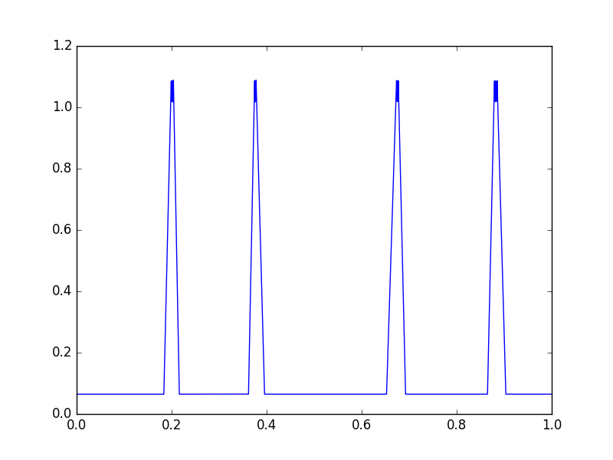
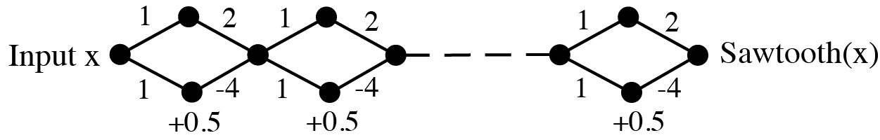
Is expressivity typical or just possible?
Hanin & Rolnick (2019)
Sawtooth function
Weights, biases + noise (normal std dev 0.1)
Notes:
Done

Slide 23
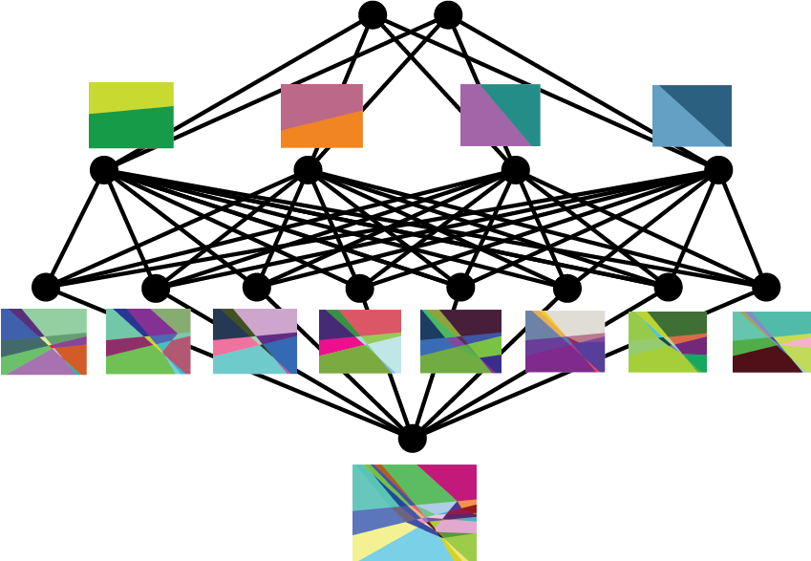

Linear regions in ReLU nets
Plane through 3 MNIST examples Depth 3, width 64 network at init
Hanin & Rolnick (2019)
Notes:
Done

Slide 24
Linear regions in ReLU nets
The number of linear regions in a ReLU network (which is piecewise linear) can be exponential in the depth. (Montufar et al. 2014)
Hanin & Rolnick (2019) - the regions for a typical ReLU net at initialization.
Theorem 1: The expected number of regions that intersect any 1D trajectory (e.g. a line) per unit length is linear in N, the total number of neurons.
Theorem 2: The expected surface area of the total boundary between regions, per unit volume, is linear in N.
Theorem 3: The expected distance to the nearest region boundary scales as 1/N.
For n-dimensional input, number of regions conjectured to grow as (depth)^{n}.
Notes:
Done

Slide 25
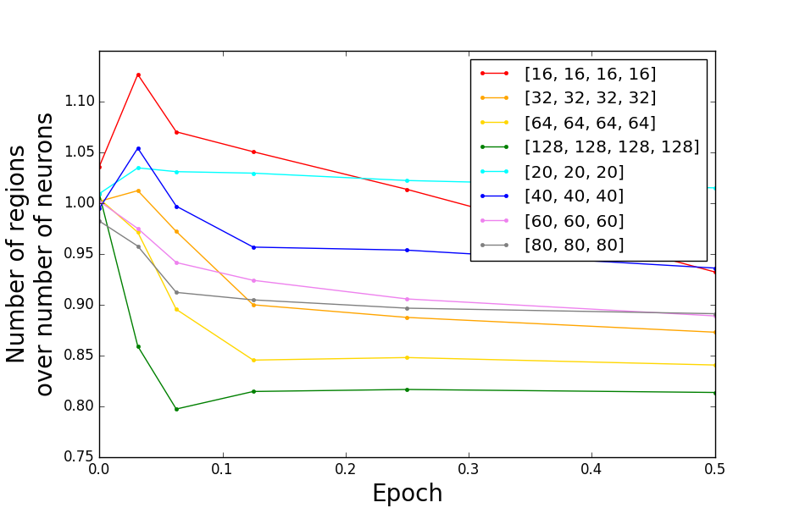
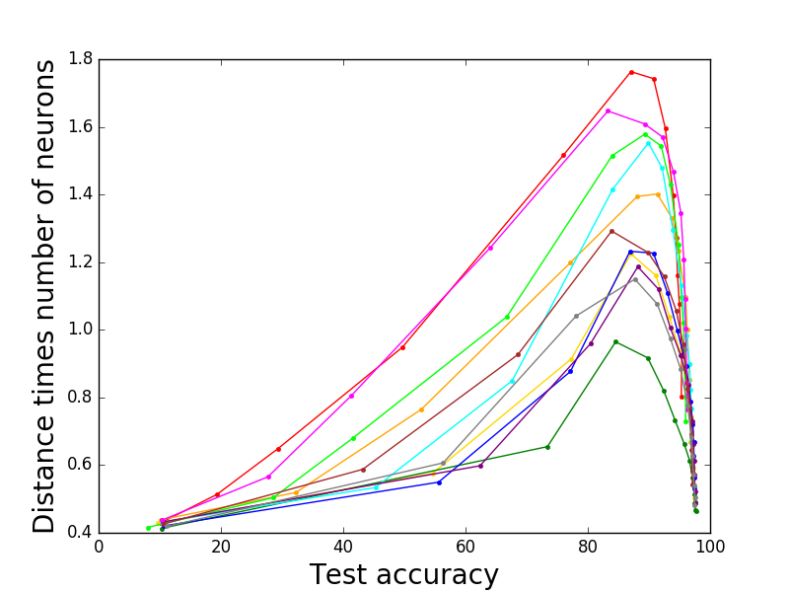
Linear regions in ReLU nets
Hanin & Rolnick (2019)
Notes:
Done

Slide 26
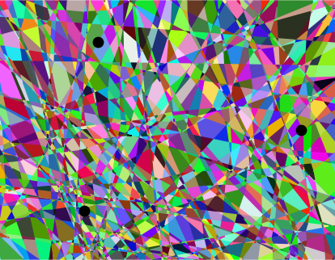
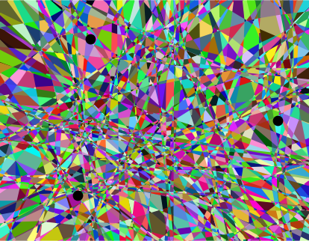
Linear regions in ReLU nets
Initialization
Epoch 1
Epoch 20
Hanin & Rolnick (2019)
Notes:
Done

Slide 27
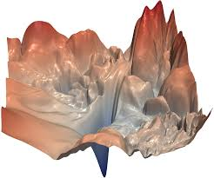
Loss landscapes of neural networks
The loss landscape refers to how the loss changes over parameter space.
The dimension of parameter space is very high (potentially millions).
Learning aims to find a global minimum.
On right is a surface plot with z = loss and xy = a 2D projection of params. The individual directions in the projection are normalized by the network weights.
Li et al. (2018)
Notes:
Done

Slide 28
Local optima, saddle points
The classic worry of optimization is that one can fall into a local optimum.
(This is why convex optimization is great - local minima are global.)
But actually for deep networks there is another problem.
Local minima are rare but saddle points are common (Dauphin et al. 2014).
Why is this the case?
Eigenvalues of the Hessian are like for a random matrix, but shifted right by an amount determined by the loss at the point in question (Bray and Dean 2007).
Saddle points look like plateaus.
Notes:
Done

Slide 29
Learning XOR
Consider the following problem for S a subset of {1, 2, …, d}: For each d-dimensional binary input x, compute the XOR of coordinates of x indexed by S.
Theorem (Shalev-Shwartz et al. 2017). As S varies, the gradient of the loss between a predictor and the true XOR is tightly concentrated - that is, the gradient doesn’t depend strongly on S. (Formally, the variance of the gradient with respect to S is exponentially small in d.)
The loss landscape is exponentially flat - except right around the minimum.
Notes:
Done

Slide 30



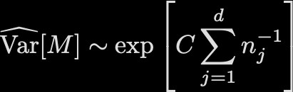
Exploding & vanishing - theory and practice
Hanin & Rolnick (2018): ReLU networks at initialization, randomly initialized weights i.i.d. with variance:
Consider the squared length of the activation vector at layer j, normalized by the width:
Theorem 1. The mean across initializations is exponential in .
Theorem 2. The variance of the squared length between layers is exponential in the sum of reciprocals of layer widths:
Hanin 2018: The variance of gradients of the network is also exponential in this quantity.
Notes:
Done

Slide 31
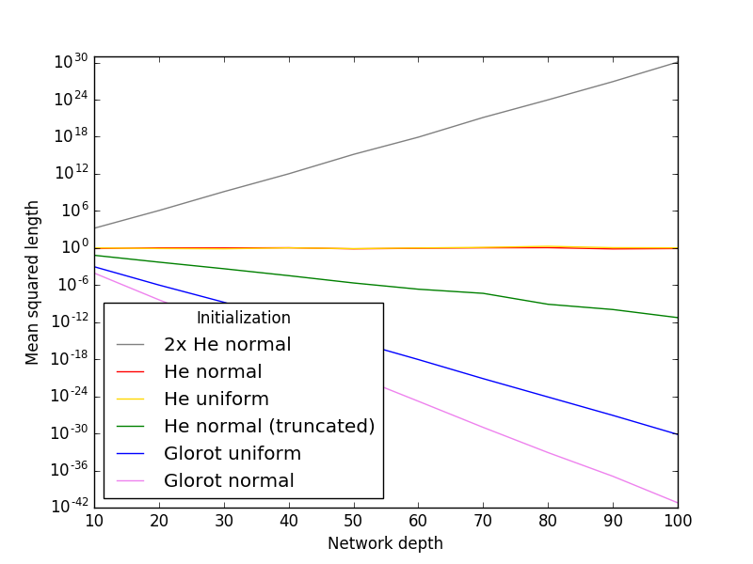
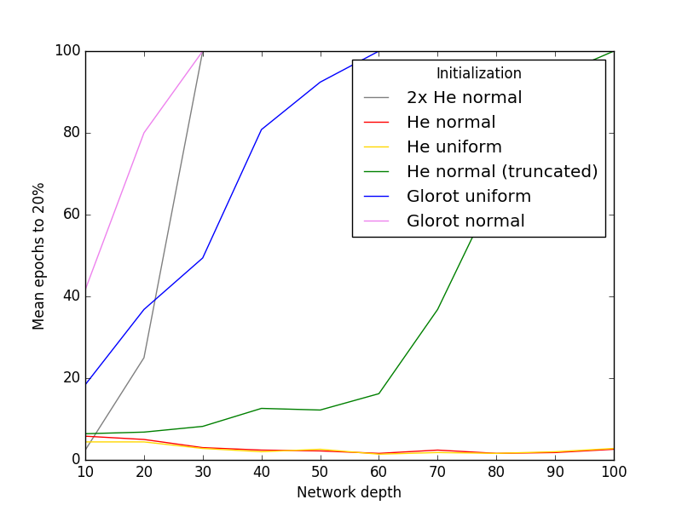
Exploding & vanishing - initialization
Exponential growth of the mean squared length of the output vector for many popular initializations.
The negative impact of very large and small output lengths on early training over MNIST.
Hanin & Rolnick (2018)
Notes:
Done

Slide 32
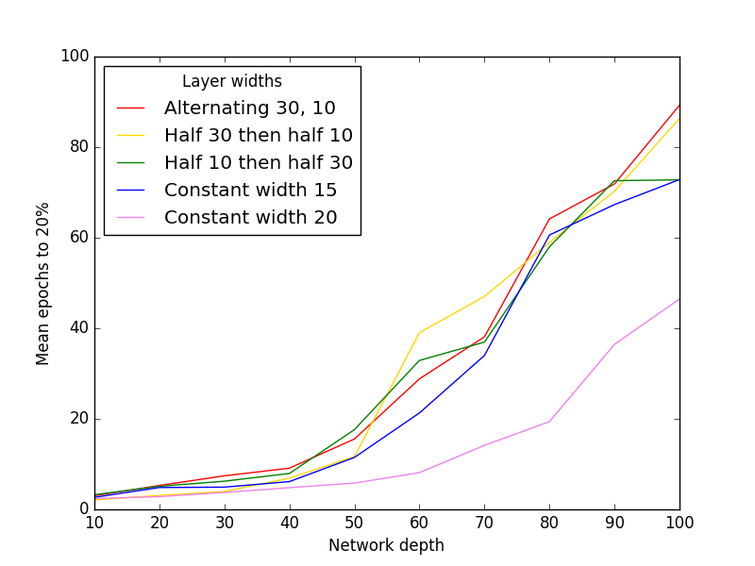
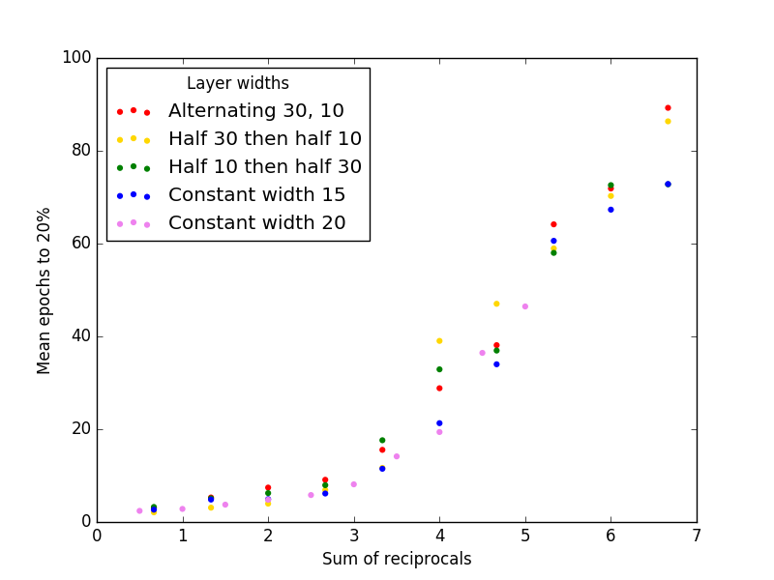
Exploding & vanishing - architecture
Early training dynamics for a variety of architectures when training on MNIST. In the left panel, the pink curve has a smaller sum of reciprocals at each depth, while all other curves have the same (larger) sum.
Hanin & Rolnick (2018)
Notes:
Done

Slide 33
Exploding & vanishing - takeaways
Poor initialization and poor architecture both stop networks from learning.
Initialization:
Use i.i.d. weights with variance 2/fan-in (e.g. He normal / He uniform).
Watch out for truncated normals!
Architecture:
Width (or #features in ConvNets) should grow with depth.
Even a single narrow layer makes training hard.
Notes:
Done

Slide 34
Summary: depth and width
Depth is really useful, but diminishing returns.
Very deep networks are probably more useful based on their learning biases than because of their expressivity.
Deeper networks in practice learn more complex functions but harder to train at all.
(ResNets make it easier to train deep networks.)
Wider networks are easier to train.
There is no absolute rule here, sorry!
Notes:
Done

Slide 35
ResNets
Notes:
Done

Slide 36
What is a ResNet?
He et al. (2016)

Slide 37
Information flow in ResNets
Veit et al. (2016)

Slide 38
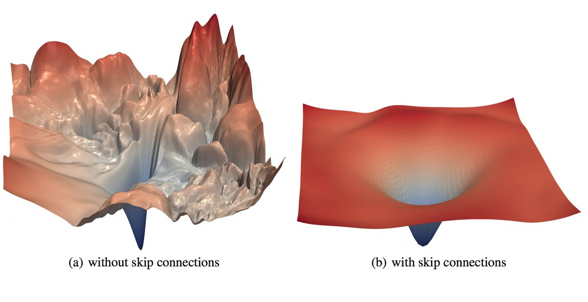
Loss landscape of ResNets
Li et al. (2018)
Notes:
Done

Slide 39
DenseNets

